Slide 1
Natural Language Processing (Before LLMs)

Slide 2
What is NLP?
CS
AI
Natural Language Processing (NLP) is a field at the intersection of computer science, artificial intelligence, and linguistics that focuses on enabling computers to understand, interpret, generate, and respond to human language in a meaningful way.
NLP
Linguistics
Three reasons for computers to do NLP:
It is more convenient for humans to communicate with machines using natural language rather than a formal language like a first-order predicate calculus.
Communicate with humans.
To learn.
Knowledge is stored as natural language and not in a formal logic.
Advance scientific understanding of languages and language use.

Slide 3
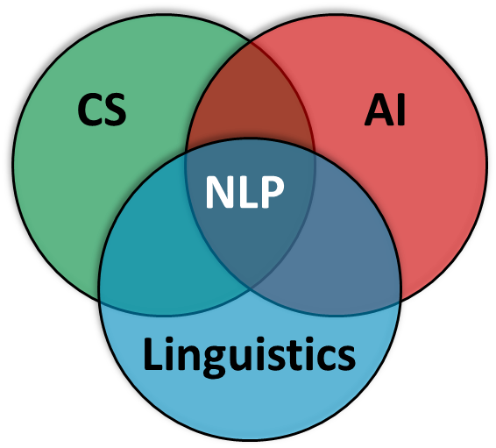
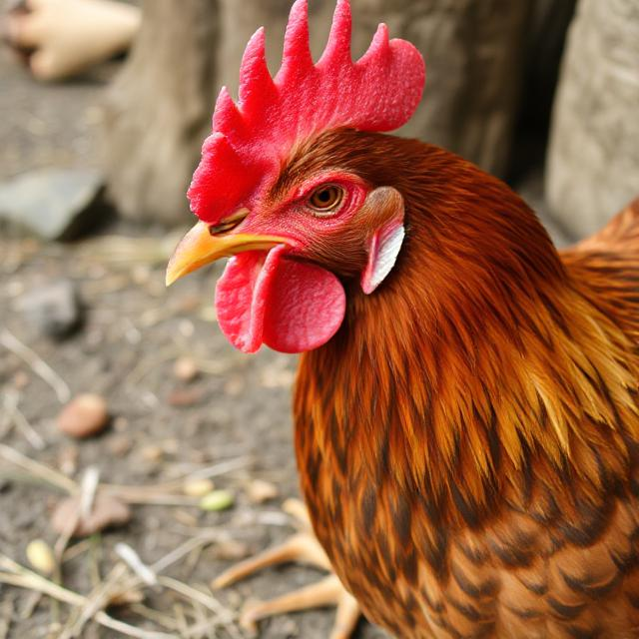

Goals / Challenge
Goals
Understanding: Extract meaning from text
Generation: Produce coherent, meaningful text
Translation: Convert between languages
Question Answering: Retrieve information from text
Dialogue: Interact naturally with humans
Challenge
Natural language is ambiguous, context-dependent, and highly variable
The chicken is ready to eat.
Ambiguous
Is the chicken hungry, or is it cooked and ready to be eaten?
one expression → many meanings
Context-Dependent
In a restaurant (food), on a farm (animal behavior)
one expression; meanings depends on the situation
Variable
“The cooked chicken is ready to be consumed”
“The chicken is prepared”
“The chicken is done”
Multiple expressions → one meaning

Slide 4
World Knowledge
Understanding language often requires knowledge about how the world works, not just linguistic knowledge.
Pronoun Resolution
“The trophy didn't fit in the suitcase because it was too small”
“The trophy didn't fit in the suitcase because it was too big”
We need to understand that objects must be smaller than their containers
Physical Constraints
“I poured water from the bottle into the cup until it was full”
“I poured water from the bottle into the cup until it was empty”
We need to understand that liquids flow from source to destination
Social/Biological Knowledge
“Bob and Joe are fathers”
“Bob and Joe are brothers”
Same grammatical structure, but different relationship implications
Temporal/Causal Reasoning
“The ice melted because it was hot”
“The ice melted so I was hot”
We need to understand “because” indicates cause, “so” indicates consequence

Slide 5
Historical Approaches to NLP
Hand-crafted grammars and rules
Parse trees, formal grammars, logic-based reasoning
Limitation: Limited coverage, brittle (breaks on unexpected input)
Required enormous manual effort to handle linguistic variation
1950s-1980s
Symbolic/Rule-Based
Learn patterns from data rather than hand-code rules
Use probability theory to handle uncertainty and variation
N-gram models, Hidden Markov Models (HMMs), Probabilistic Context-Free Grammars (PCFGs)
Advantage: Robust, handles unseen cases better
1990s-2010s
Statistical/Probabilistic
Focus of these slides.
2010s-Present
Neural Networks
Deep learning: learn multiple levels of representation automatically
Word embeddings (2013), Recurrent Neural Networks, Transformers (2017)
Modern Large Language Models: GPT, BERT, Claude, ChatGPT
Breakthrough: Can learn complex patterns from massive amounts of text
Requires large datasets and computational resources

Slide 6
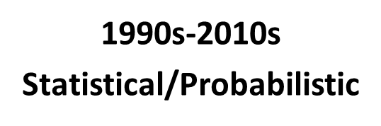
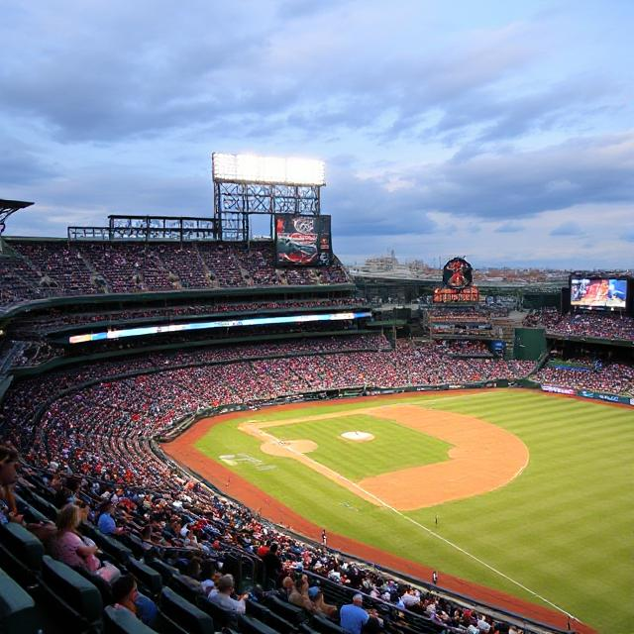

Language Models: Motivation
Complete the phrase:
Take me out to the …
ballgame
Bukra …
inshallah
I forgot my …
No clear successor word.
Problem
How do we assign probability to sentences (or subsequent words)?
Many NLP tasks require assessing how “likely” or “fluent” a sentence is:
Speech recognition: “I saw a van” versus “Eyes awe of an”
Homophones.
Machine translation: “strong tea” versus “powerful tea”
Both are possible, but which is more natural?
Spelling correction: “I ate dessert” versus “I ate desert”
Text generation: What word should come next?

Slide 7
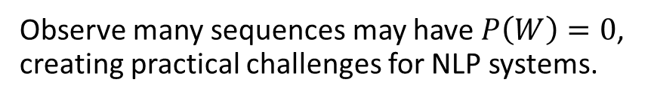
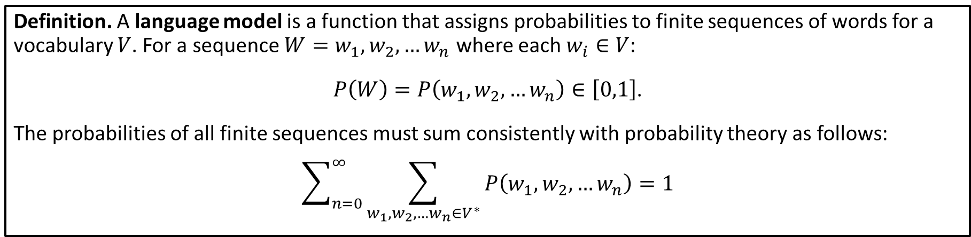
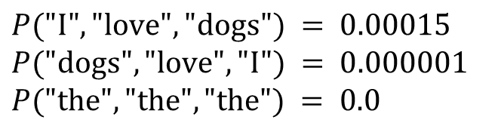
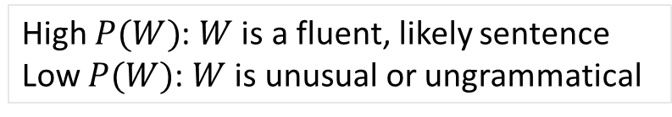
Naïve Language Model
Definition. A language model is a function that assigns probabilities to finite sequences of words for a vocabulary $V$. For a sequence $W=w_{1},w_{2},…w_{n}$ where each $w_{i}∈V$:
$P\left(W\right)=P\left(w_{1},w_{2},…w_{n}\right)∈\left[0,1\right]$.
The probabilities of all finite sequences must sum consistently with probability theory as follows:
$$\sum_{n=0}^{∞}{\sum_{w_{1},w_{2},…w_{n}∈V^{∗}}{P\left(w_{1},w_{2},…w_{n}\right)}}=1$$
$$P("I", "love", "dogs") = 0.00015$$
$$P("dogs", "love", "I") = 0.000001$$
$$P("the", "the", "the") = 0.0$$
Examples
(different sequence, different probability)
(ungrammatical, zero probability)
Observe many sequences may have $P\left(W\right)=0$, creating practical challenges for NLP systems.
High $P(W)$: $W$ is a fluent, likely sentence
Low $P(W)$: $W$ is unusual or ungrammatical

Slide 8
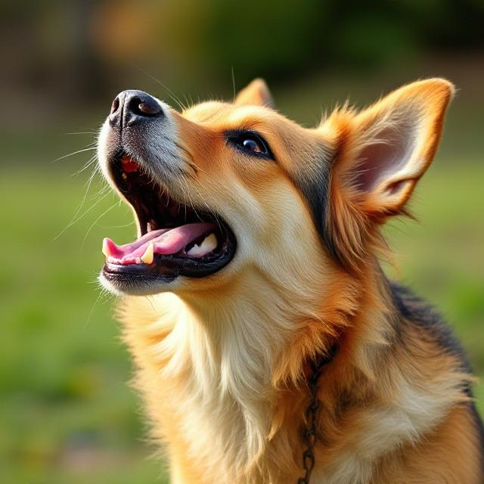
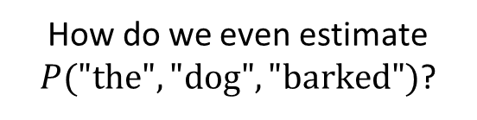
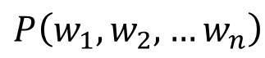
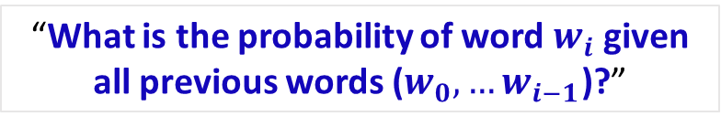
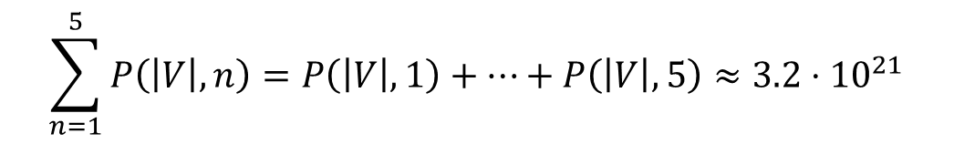
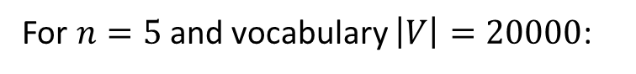
Reconsidering the Language Model Definition
Our original definition for a language model used a joint probability computation:
$$P\left(w_{1},w_{2},…w_{n}\right)$$
(Joint probability refers to the likelihood that two or more events occur simultaneously.)
How many possible sequences?
For $n=5$ and vocabulary $\left|V\right|=20000$:
Infinite considering all possible lengths!
$$\sum_{n=1}^{5}{P\left(\left|V\right|,n\right)}=P\left(\left|V\right|,1\right)+…+P\left(\left|V\right|,5\right)≈3.2⋅{10}^{21}$$
We cannot possibly enumerate or store all probabilities.
How do we even estimate $P("the", "dog", "barked")$?
Instead, why not ask the question:
“What is the probability of word $w_{i}$given all previous words ($w_{0},…w_{i−1}$)?”

Slide 9
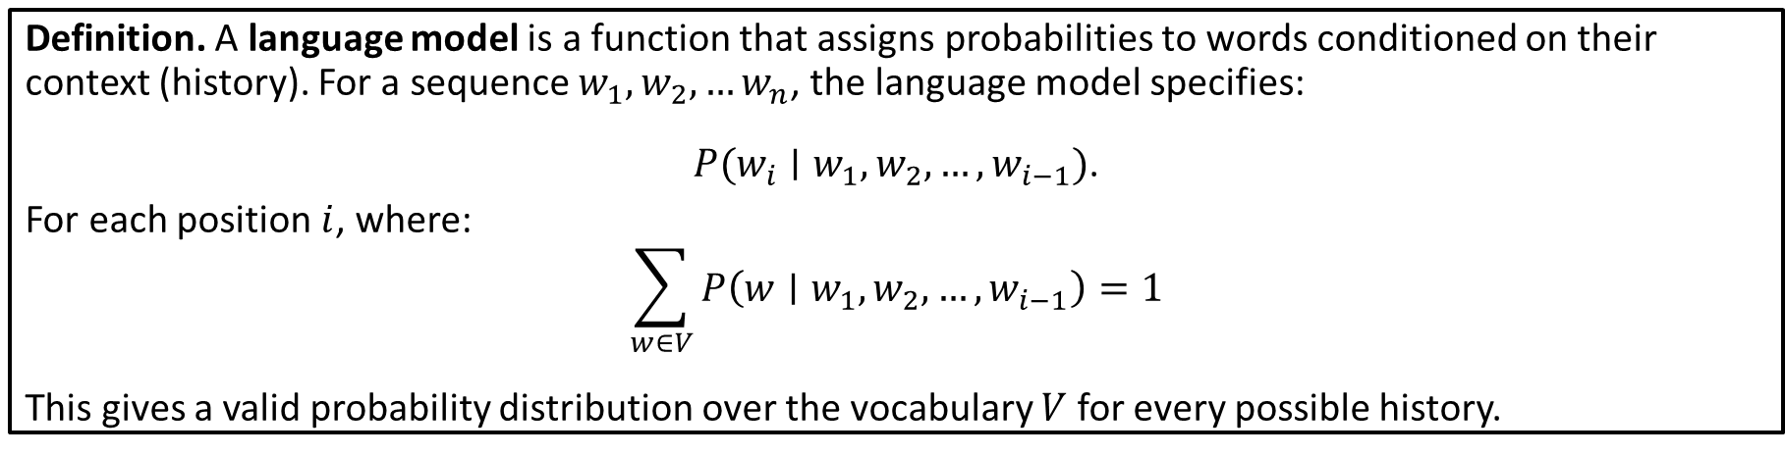
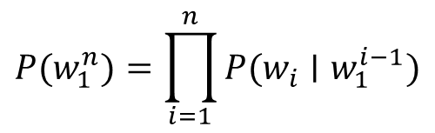
Language Model Version II
Any joint probability can be decomposed (using the Chain Rule of Probability):
$$P(w_{1}​,w_{2}​,…,w_{n}​)=P(w_{1}​)⋅P(w_{2}​∣w_{1}​)⋅P(w_{3}​∣w_{1}​,w_{2}​)⋯P(w_{n}​∣w_{1}​,…,w_{n−1}​)$$
Generally:
$$P(w_{1}^{n}​​)=\prod_{i=1}^{n}{P(w_{i}​∣w_{1}^{i−1}​)}$$
Definition. A language model is a function that assigns probabilities to words conditioned on their context (history). For a sequence $w_{1},w_{2},…w_{n}$, the language model specifies:
$P(w_{i}​∣w_{1}​,w_{2},…,w_{i−1}​)$.
For each position $i$, where:
$$\sum_{w∈V}{P\left(w∣w_{1}​,w_{2},…,w_{i−1}​\right)}=1$$
This gives a valid probability distribution over the vocabulary $V$ for every possible history.

Slide 10
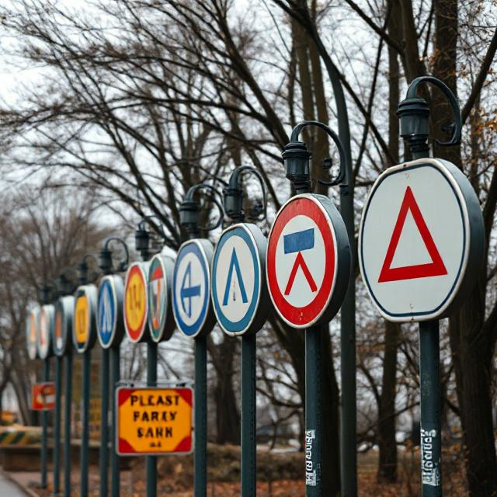
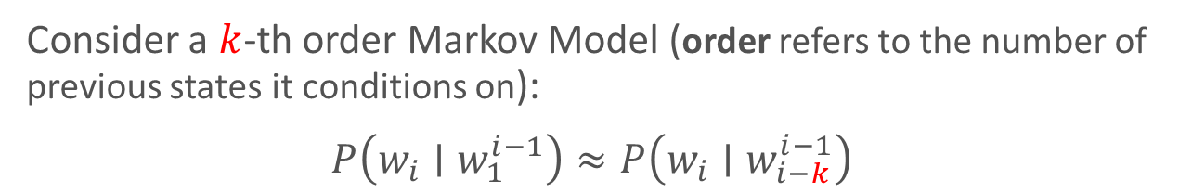
Markov Assumption
Challenge: From data (text corpus), we cannot estimate reliably for long histories due to data sparsity.
Modern Large Language Models (LLMs) overcome this challenge using neural networks to learn abstract patterns and representations rather than memorizing exact sequences, enabling them to generalize to unseen contexts and handle histories of thousands of words through Transformer architectures with attention mechanisms.
Solution: Limit the context window!
Markov Assumption: The probability of a word depends only on a fixed number of previous words.
Consider a $k$-th order Markov Model (order refers to the number of previous states it conditions on):
$$P\left(w_{i}∣w_{1}^{i−1}\right)≈P\left(w_{i}∣w_{i−k}^{i−1}\right)$$
This is the idea behind $n$-gram models where $n=k+1$.

Slide 11
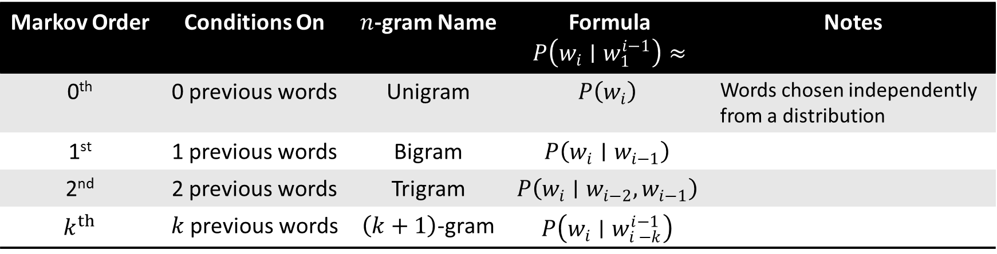
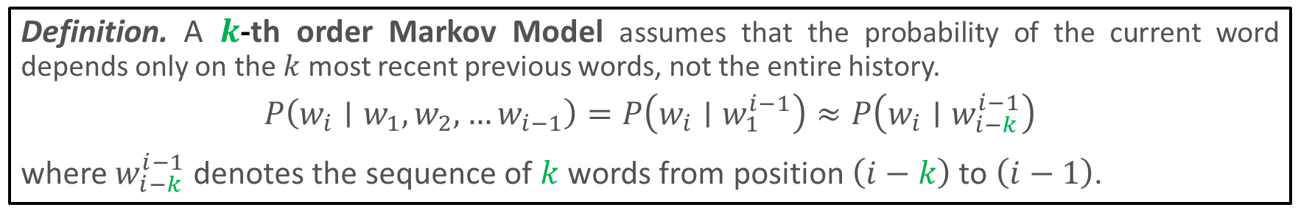
$n$-gram Models
Definition. A $k$-th order Markov Model assumes that the probability of the current word depends only on the $k$ most recent previous words, not the entire history.
$$P\left(w_{i}∣w_{1},w_{2}, …w_{i−1}\right)=P\left(w_{i}∣w_{1}^{i−1}\right)≈P\left(w_{i}∣w_{i−k}^{i−1}\right)$$
where $w_{i−k}^{i−1}$ denotes the sequence of $k$ words from position $\left(i−k\right)$ to $\left(i−1\right)$.
Markov Order | Conditions On | $n$-gram Name | Formula $P\left(w_{i}∣w_{1}^{i−1}\right)≈$ | Notes
0th | 0 previous words | Unigram | $$P\left(w_{i}\right)$$ | Words chosen independently from a distribution
1st | 1 previous words | Bigram | $$P\left(w_{i}∣w_{i−1}\right)$$
2nd | 2 previous words | Trigram | $$P\left(w_{i}∣w_{i−2},w_{i−1}\right)$$
$k^{th}$ | $k$ previous words | $\left(k+1\right)$-gram | $$P\left(w_{i}∣w_{i −k}^{i−1}\right)$$

Slide 12
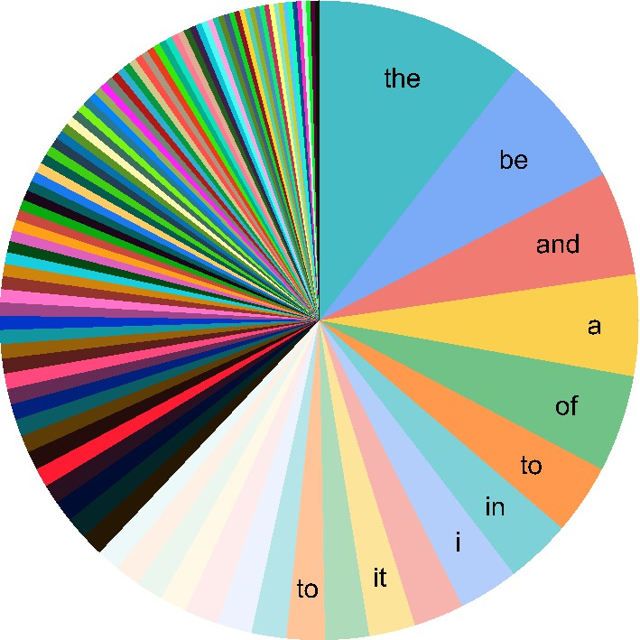
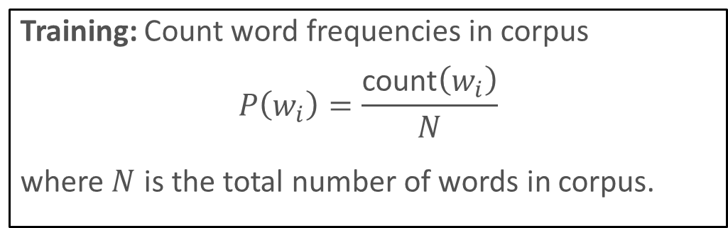
Example: Unigram Model
Training: Count word frequencies in corpus
$$P\left(w_{i}\right)=\frac{\text{count}\left(w_{i}\right)}{N}$$
where $N$ is the total number of words in corpus.
Some generated sentences from a unigram model:
fifth, an, of, futures, the, an, incorporated, a, a, the, inflation, most, dollars, quarter, in, is, mass
thrift, did, eighty, said, hard, 'm, july, bullish
that, or, limited, the
Jurafsky Slides
Sample probability distribution for a corpus.
Individual words seem reasonable
No coherence or grammatical structure
Words appear with roughly correct frequencies

Slide 13
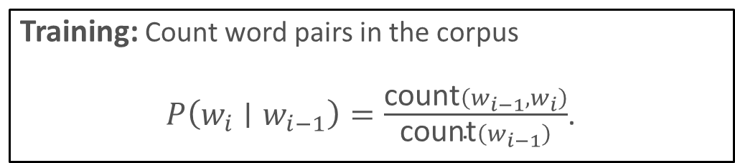
Example: Bigram Model
Training: Count word pairs in the corpus
$P\left(w_{i}∣w_{i−1}\right)=\frac{\text{count}\left({w_{i−1},w}_{i}\right)}{\text{count}\left(w_{i−1}\right)}$.
For Bigram models, the present depends on the immediate past.
Some generated sentences from a bigram model:
texaco, rose, one, in, this, issue, is, pursuing, growth, in, a, boiler, house, said, mr., gurria, mexico, 's, motion, control, proposal, without, permission, from, five, hundred, fifty, five, yen
outside, new, car, parking, lot, of, the, agreement, reached
this, would, be, a, record, november
Jurafsky Slides
Local coherence (pairs make sense)
Some grammatical structure
Still incoherent globally

Slide 14
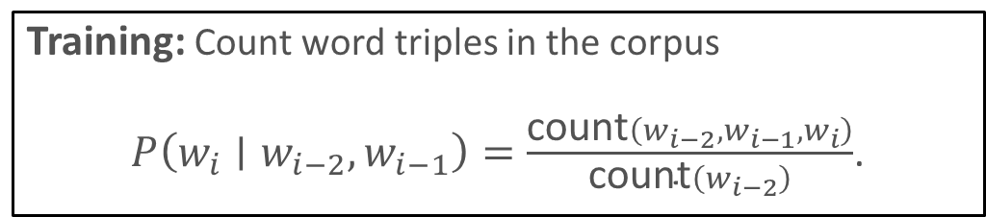
Example: Trigram Model
Training: Count word triples in the corpus
$P\left(w_{i}∣w_{i−2},w_{i−1}\right)=\frac{\text{count}\left({w_{i−2},w_{i−1},w}_{i}\right)}{\text{count}\left(w_{i−2}\right)}$.
Some generated sentences from a trigram model:
neural network that perfectly fits a finite dataset
statistical learning cannot justify parameter counts from interpolation alone in the same way
any first order theory with an infinite model also has a countable model compression knowledge distillation generalization theory the epistemology of deep learning and the criticism of the bigger is better doctrine
Better local coherence
More grammatical
Still lacks long-range coherence

Slide 15
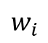
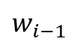
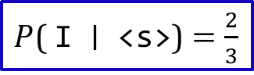
Bigram Example
Example corpus
<s> I am Sam </s>
<s> Sam I am </s>
<s> I do not like green eggs and ham </s>
$$w_{i}$$
$$w_{i−1}$$
 | <s> | I | am | Sam | do | not | like | green | eggs | and | ham | </s> | TOTAL
<s> | 0 | 2 | 0 | 1 | 0 | 0 | 0 | 0 | 0 | 0 | 0 | 0 | 3
I | 0 | 0 | 2 | 0 | 1 | 0 | 0 | 0 | 0 | 0 | 0 | 0 | 3
am | 0 | 0 | 0 | 1 | 0 | 0 | 0 | 0 | 0 | 0 | 0 | 1 | 2
Sam | 0 | 1 | 0 | 0 | 0 | 0 | 0 | 0 | 0 | 0 | 0 | 1 | 2
do | 0 | 0 | 0 | 0 | 0 | 1 | 0 | 0 | 0 | 0 | 0 | 0 | 1
not | 0 | 0 | 0 | 0 | 0 | 0 | 1 | 0 | 0 | 0 | 0 | 0 | 1
like | 0 | 0 | 0 | 0 | 0 | 0 | 0 | 1 | 0 | 0 | 0 | 0 | 1
green | 0 | 0 | 0 | 0 | 0 | 0 | 0 | 0 | 1 | 0 | 0 | 0 | 1
eggs | 0 | 0 | 0 | 0 | 0 | 0 | 0 | 1 | 0 | 1 | 0 | 0 | 1
and | 0 | 0 | 0 | 0 | 0 | 0 | 0 | 0 | 0 | 0 | 1 | 0 | 1
ham | 0 | 0 | 0 | 0 | 0 | 0 | 0 | 0 | 0 | 0 | 0 | 1 | 1
</s> | 0 | 0 | 0 | 0 | 0 | 0 | 0 | 0 | 0 | 0 | 0 | 0 | 0
TOTAL | 0 | 3 | 2 | 2 | 1 | 1 | 1 | 1 | 1 | 1 | 1 | 3 | 17
Pairwise Count Matrix
$P$( I ∣ <s>)$=\frac{2}{3}$

Slide 16
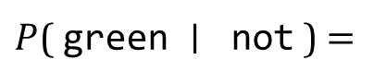
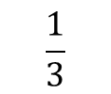
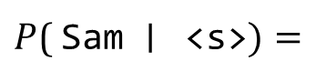
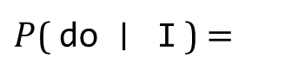
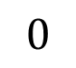
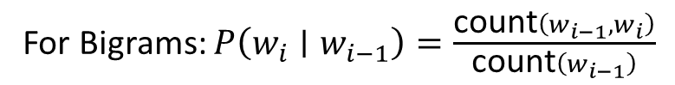
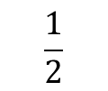
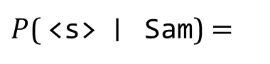
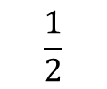
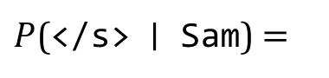
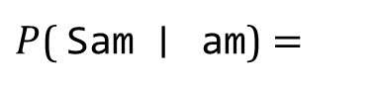
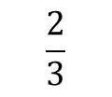
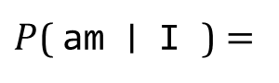
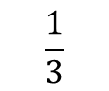
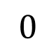
Example (continued)
For Bigrams: $P\left(w_{i}∣w_{i−1}\right)=\frac{\text{count}\left({w_{i−1},w}_{i}\right)}{\text{count}\left(w_{i−1}\right)}$
$$\frac{1}{3}$$
$$\frac{2}{3}$$
$$\frac{1}{2}$$
$P$( Sam ∣ <s>$)=$
$P$( am ∣ I )$=$
$P$(</s> ∣ Sam)$=$
$$0$$
$$\frac{1}{3}$$
$$0$$
$P$( <s> ∣ Sam)$=$
$P$( do ∣ I )$=$
$P$( green ∣ not )$=$
$$\frac{1}{2}$$
$P$( Sam ∣ am)$=$
<s> I am Sam </s>
<s> Sam I am </s>
<s> I do not like green eggs and ham </s>

Slide 17


Question
Which of the following are bigrams from the sentence
“It is cold outside today”?
“It is”
“cold today”
“is cold”
Both A and C
Bigrams from this sentence:
(It, is)
(is, cold)
(cold, outside)
(outside, today)
In a bigram model, what assumption do we make?
All words are independent
Each word depends on all previous words
Each word depends only on the immediately previous word
Words are chosen uniformly at random

Slide 18
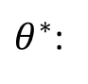
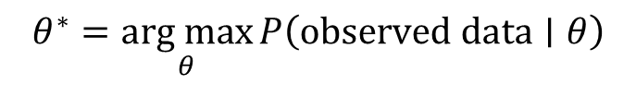
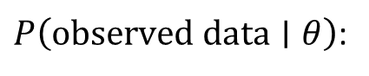
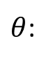
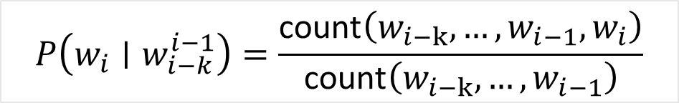
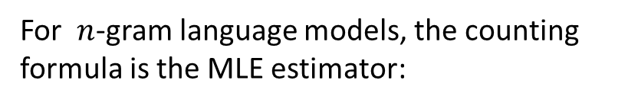
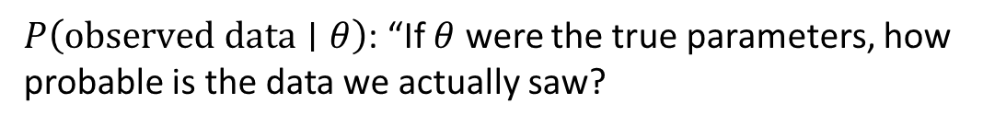
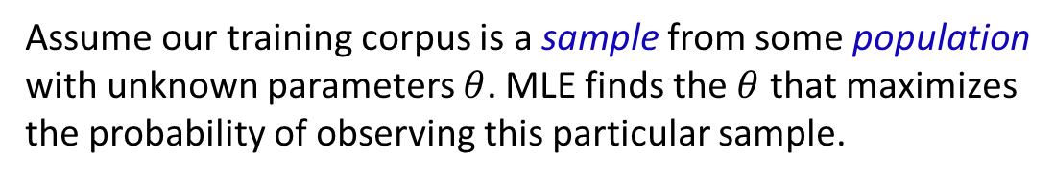

Maximum Likelihood Estimation (MLE)
Assume our training corpus is a sample from some population with unknown parameters $θ$. MLE finds the $θ$ that maximizes the probability of observing this particular sample.
$$θ^{∗}=\underset{θ}{arg max}{P\left(observed data∣θ\right)}$$
$θ$:
The parameters we want to estimate (e.g., all bigram probabilities)
$P\left(observed data∣θ\right)$:
$P\left(observed data∣θ\right)$: “If $θ$ were the true parameters, how probable is the data we actually saw?
$\underset{θ}{arg max}$:
"The argument (value of θ) that maximizes..."
$θ^{∗}$:
The best parameter estimate.
For $n$-gram language models, the counting formula is the MLE estimator:
$$P\left(w_{i}∣w_{i−k}^{i−1}\right)=\frac{\text{count}\left({w_{i−k},…,w}_{i−1},w_{i}\right)}{\text{count}\left({w_{i−k},…,w}_{i−1}\right)}$$
By the Law of Large Numbers, as training data size increases (toward $∞$), MLE estimates converge to true probabilities.

Slide 19




Practical Issues: Log Probability Space
With large vocabularies (10,000+ words), individual word probabilities are small (e.g., P(word) ≈ 0.0001). For long sequences, we must multiply many such small probabilities together. This may result in underflow.
$$P(w_{1}^{n})=\prod_{i=1}^{n}{P}(w_{i}|w_{i−1})$$
As a workaround we could work in log space:
$$\text{log} P(w_{1}^{n})=\sum_{i=1}^{n}{\text{log}}P(w_{i}|w_{i−1})$$
This helps avoid underflow since addition is faster than multiplication.
It is also order preserving: $P\left(A\right)>P\left(B\right)⇔\text{log} P\left(A\right)>\text{log} P\left(B\right)$.

Slide 20





Zero Probability Problem
What if we encounter an n-gram never seen in training?
$$P({\text{word}}_{i}|{\text{word}}_{i−1})=\frac{\text{count}({\text{word}}_{i−1},{\text{word}}_{i})}{\text{count}({\text{word}}_{i−1})}=\frac{0}{...}=0$$
The entire sentence would then have probability 0:
$$P\left(w_{1}^{n}\right)=\prod_{i=1}^{n}{P}\left(w_{i} | w_{i−1}\right)=… ⋅0⋅ ⋯=0$$
In the NLP setting, test data will always contain unseen $n$-grams. Thus, the model will become useless for unseen events.
Theoretically, real probabilities should be small, not zero.
Smoothing is a solution to this problem where we redistribute probability mass from the ‘seen’ data to the ‘unseen’.

Slide 21









$$P\left(w_{i}∣w_{i−k}^{i−1}\right)=\frac{\text{count}\left({w_{i−k},…,w}_{i−1},w_{i}\right)}{\text{count}\left({w_{i−k},…,w}_{i−1}\right)}$$
Smoothing: Add One
Unsmoothed
What if we pretend every $n$-gram has been observed at least one time?
Add-one Smoothing
$$P\left(w_{i} | w_{i−k}^{i−1}\right)=\frac{\text{count}\left({w_{i−k},…,w}_{i−1},w_{i}\right)+1}{\text{count}\left({w_{i−k},…,w}_{i−1}\right)+\left|V\right|}$$
Why $\left|V\right|$ (where $\left|V\right|$ is vocabulary size) in the denominator?
$$\sum_{w∈V}{P\left(w_{i}|w_{i−k}^{i−1}\right)}=\sum_{w∈V}{\frac{\text{count}\left({w_{i−k},…,w}_{i−1},w_{i}\right)+1}{\text{count}\left({w_{i−k},…,w}_{i−1}\right)+\left|V\right|}}$$
$$=\frac{1}{\text{count}\left({w_{i−k},…,w}_{i−1}\right)+\left|V\right|}\sum_{w∈V}{\text{count}\left({w_{i−k},…,w}_{i−1},w_{i}\right)+1}$$
# Constant denominator
$$=\frac{1}{\text{count}\left({w_{i−k},…,w}_{i−1}\right)+\left|V\right|}\left[\sum_{w∈V}{\text{count}\left({w_{i−k},…,w}_{i−1},w_{i}\right)}+\sum_{w∈V}{1}\right]$$
Observe, $\text{count}\left({w_{i−k},…,w}_{i−1}\right)=\sum_{w∈V}{\text{count}\left({w_{i−k},…,w}_{i−1},w_{i}\right)}$.
Also observe, $\sum_{w∈V}{1=\left|V\right|}$. So,
# All words that follow ${w_{i−k},…,w}_{i−1}$
Simple to implement
No zero $n$-gram probabilities
Warning: Often reduces probability of seen events too much (over-smoothing)
$$\sum_{w∈V}{P\left(w_{i}|w_{i−k}^{i−1}\right)}=1$$

Slide 22


Generalized Smoothing: Add $α$
We can generalize smoothing by integrating a constant $0<α<1$ where $α$ represents how many imaginary observations we add to each $n$-gram (pseudo-counts).
General Smoothing
$$P\left(w_{i} | w_{i−k}^{i−1}\right)=\frac{\text{count}\left({w_{i−k},…,w}_{i−1},w_{i}\right)+α}{\text{count}\left({w_{i−k},…,w}_{i−1}\right)+α\left|V\right|}$$
Other benefits
More flexible than add-one: α is a tunable hyperparameter
Less over-smoothing: Reduces probability of seen events less dramatically
Better empirical performance: $α<1$ typically works better than $α=1$.
Tunable on held-out data: Optimize $α$ on a validation set for best performance
Controls bias-variance tradeoff:
Smaller α → lower bias, higher variance;
larger α → higher bias, lower variance

Slide 23








Smoothing Matters for Large $n$
Suppose $\left|V\right|=20000$ and let $k$ refer to a sequence of consecutive terms: $k$-grams.
How many $k$-grams are possible?
$${\left|V\right|}^{k}$$
We can compute a sparsity ratio:
$$Sparsity=\frac{V^{k}}{N}$$
Now suppose we have a corpus of size $N=1,000,000$.
What is the maximum number of distinct $k$-grams that would be observable in the corpus?
$$N$$
$k$-gram | $$V^{k}$$ | Corpus ($N$) | Sparsity | Fraction Unseen
$k=1$ (unigram) | 20,000 | 1,000,000 | 0.02 | $$0.02$$
$k=2$ (bigram) | 400M | 1,000,000 | 400 | $$>0.997$$
$k=3$ (trigram) | 8T | 1,000,000 | 8M | $$>0.9999$$
$k=4$ (4-gram) | 160 quadrillion | 1,000,000 | 160B | $$≈1.0$$
$$\lim_{k→∞}{\frac{V^{k}}{N}=}$$
$$∞$$
Since $V^{k}$ grows exponentially while the corpus is fixed, larger $k$-grams are almost never observed. Smoothing is essential to handle the inevitable unseen sequences in test data.

Slide 24


Question
Smoothing is increasingly useful for n-grams when:
$n$ gets larger
$n$ gets smaller
Always the same
$n$ larger than $10$
Larger $n$ implies:
more possible $n$-grams
More sparsity in training data
More zero counts
There is a greater need to handle unseen events with more zero counts.

Slide 25
Language Model Evaluation
Extrinsic Evaluation (End-to-End)
Approach: Embed model in application (translation, speech recognition) and measure task-specific performance (accuracy, error rate, quality scores)
Example: Compare language models by their impact on spelling correction accuracy
Intrinsic Evaluation (Standalone)
Method: Evaluate language model in isolation on held-out test data
Measure: Perplexity - how well the model predicts test sequences
Example: Compute perplexity on test corpus, lower is better
HERE: Tighten Intrinsic and boxes below.
Directly meaningful - measures what we care about
Task-relevant - shows real-world performance
Gold standard for model selection
Fast - no need to build full application
Easy to compare - single number comparison between models
Reproducible - standard benchmark datasets
Positives
May not correlate with downstream task performance
Lower perplexity doesn't guarantee better application results
Disconnected from end goal
Expensive - requires full application pipeline
Slow - each evaluation takes significant time
Confounded - improvements could be from other system components, not the language model
Negatives

Slide 26
Entropy, Cross Entropy, and Perplexity

Slide 27



Measuring Uncertainty
How do we measure how uncertain (‘surprised’) we are by an outcome?
Examples
Flipping a fair coin
Rolling a weighted die that almost always shows 6.
Extremely Uncertain (50/50)
High Certainty
NLP Example: Sentiment analysis
“This movie was terrible!”
“The film had some good moments but overall disappointing.”
“This is the best movie ever!”
High certainty
High uncertainty
High Certainty
We need a mathematical way to quantify this uncertainty.

Slide 28
Programming Idea: Huffman Coding to reinforce information content.
Great question! Here are some ways to connect Huffman coding to AI concepts:
Assignment Ideas
1. Information Theory Meets Decision Trees
Have students build a Huffman tree from a text corpus
Calculate the entropy of character/word distributions
AI Connection: Compare Huffman tree construction (greedy, probability-based splitting) to decision tree construction (information gain-based splitting)
Show how both use information theory to build optimal trees
2. Text Compression for NLP Preprocessing
Build Huffman codes for a text dataset
Compare compressed sizes for different text types (formal vs. casual, English vs. other languages)
AI Connection: Analyze how entropy relates to language predictability - lower entropy languages compress better, which relates to language model perplexity
Connect to tokenization strategies in NLP
3. Probability Distribution Analysis
Given different datasets (uniform random, natural language, biased data), build Huffman codes
Compute theoretical entropy vs. actual compressed size
AI Connection: Understanding probability distributions is fundamental to ML - this shows how distribution shape affects information content
Relate to why we care about data distributions in training ML models
4. Optimal Encoding for Feature Representation
Encode categorical features using Huffman coding vs. one-hot encoding
AI Connection: Show trade-offs in feature representation
Discuss why some embeddings learn "shorter codes" for common words (like word2vec frequency-based subsampling)
5. Information Bottleneck Visualization
Build Huffman codes for image data (pixel values, or simple features)
Visualize information loss with different encoding schemes
AI Connection: Relate to autoencoders and compression in neural networks - optimal encoding is about preserving information with fewer bits
My Recommendation
I'd go with #1 or #3 because they most directly reinforce the entropy concepts you're teaching. The assignment could be:
"Information Theory in Practice"
Part A: Implement Huffman coding, compute entropy, show they match
Part B: Compare to decision tree splitting on the same data
Part C: Written reflection on how information theory unifies these concepts
This makes Huffman coding a vehicle for understanding information theory, which is genuinely central to AI.

Slide 29




Information Content
Information content refers to the number of bits required in an optimal binary encoding to represent an event.
Intuition
More Abstractly
How many yes/no questions does it take to identify which event occurred?
For $n$ equally likely outcomes, the number of bits required is $\log_{2}{n}$.
When there are…
1 possibility?
0
Also observe that the probability of each outcome is $p=\frac{1}{n}$.
2 possibilities?
1
4 possibilities?
2
If we combine these two observations, we have:
8 possibilities?
3
$$\log_{2}{n=\log_{2}{\frac{1}{p}}}$$
Definition. The information content (or self-information) of an event $x$ with probability $p\left(x\right)$ is given by:
$$I\left(x\right)=−\log_{2}{p\left(x\right)}=\log_{2}{\frac{1}{p\left(x\right)}}$$
measured in bits.

Slide 30







Binary Entropy
Consider a biased coin with $P\left(Heads\right)=0.8$ and $P\left(Tails\right)=1−P\left(Heads\right)=0.2$.
In terms of information content of each outcome:
$$I\left(Heads\right)=−\log_{2}{0.8}≈0.32$$
What is the average information per coin flip?
$$I\left(Tails\right)=−\log_{2}{0.2}≈2.32$$
If we want to find the average information content per flip of the coin, we can compute the expected value:
$$0.8⋅0.32+0.2⋅2.32$$
$$=0.72$$
Definition. For a binary random variable $X$ with outcomes positive $⨁$ and negative $⊝$) over a collection $S$, the entropy is given by
$$Entropy\left(S\right)=−p_{⨁}\log_{2}{p_{⨁}}−p_{⊝}\log_{2}{p_{⊝}}$$
For simplicity, we define $0⋅\log_{2}{0=0}$.

Slide 31




Binary Entropy
All observations are 50% one class and 50% the other.
Entropy measures the average information content per trial.
Maximum uncertainty
$$Entropy\left(S\right)=1$$
Tom Mitchell, Machine Learning, page 57.
$$Entropy\left(S\right)=0$$
Complete certainty
All observations in our data are the same classification.
Exercise
Estimate $Entropy\left(Heads=0.9,Tails=0.1\right)$

Slide 32



Extending Entropy to C Classes
Definition. For a random variable $X$ with $K$ possible outcomes ($c_{1},c_{2},…,c_{K}$) over a collection $S$, the entropy is given by
$$Entropy\left(S\right)=−\sum_{i=1}^{K}{p_{c_{i}}\log_{2}{p_{c_{i}}}}$$
where $p_{{ c}_{i}}$ is the proportion of examples in $S$ with outcome $c_{i}$.
Consider the entropy of a collection with 3 classes visualized at the right.
All Class 1:
$$Entropy\left(S\right)=−\left(1\log_{2}{1}+0\log_{2}{0}+0\log_{2}{0}\right)=0$$
$$Entropy\left(S\right)=−3⋅\left(\frac{1}{3}\log_{2}{\frac{1}{3}}\right)=1.585$$
Uniform:

Slide 33






Model Comparison
Recall that a model is a system that assigns probabilities to possible outcomes.
Also recall that we discussed language models (e.g., $n$-grams) output a probability distribution $Q$ over possible next words, but …
but the words that actually occur follow some true distribution $P$.
$$M$$
$$T$$
Predicted Distribution
Ground Truth Labels
How well does $M$ approximate $T$?

Slide 34




Cross Entropy
$$T$$
$$Entropy\left(S\right)=−\sum_{i=1}^{K}{p_{c_{i}}\log_{2}{p_{c_{i}}}}$$
Entropy measures uncertainty when we know the true distribution.
Definition. For two probability distributions $T$ and $M$ over the same set of outcomes $\left\{c₁, c₂, …, c_{K}\right\}$, the cross entropy of $T$ with respect to $M$ is given by
$$CrossEntropy\left(T,M\right)=−\sum_{i=1}^{K}{p_{c_{i}}\log_{2}{q_{c_{i}}}}$$
where $p_{c_{i}}$ is the true probability of outcome $c_{i}$ and $q_{c_{i}}$ is the predicted probability of outcome $c_{i}$.
This formula can be interpreted as:
Events occur with true probabilities $p_{c_{i}}$ according to $T$
A model $M$ assigned probabilities $q_{c_{i}}$ to each event
When event $c_{i}$ occurs, the information content is given by $\log_{2}{q_{c_{i}}}$.
Cross entropy is thus the average information content across all events when using model $M$ to predict events that actually occur according to distribution $T$.

Slide 35



Example
Suppose we are building a POS tagger with 4 classes: {noun, verb, adjective, adverb}.
Consider the sentence: “The quick fox jumps over the lazy dog.”
Our goal is to ‘tag’ the word jumps.
We know the word jumps can be represented using the tagging vector:
$$T:\left[0, 1, 0, 0\right]$$
Suppose our model predicts a tagging vector:
$$M:\left[0.1, 0.7, 0.05, 0.15\right]$$
$$CrossEntropy\left(M,T\right)=−\left[0⋅\log_{2}{0.1}+1⋅\log_{2}{0.7+0⋅\log_{2}{0.05}+0⋅\log_{2}{0.15}}\right]$$
$$≈0.51$$
Observe: lower cross entropy → better prediction

Slide 36





Question
Consider two events: $P\left(A\right)=\frac{1}{2}$ and $P\left(A\right)=\frac{1}{8}$. What are their information contents?
$I\left(A\right)=2$, $I\left(B\right)=8$
$I\left(A\right)=1$, $I\left(B\right)=3$
$I\left(A\right)=3$, $I\left(B\right)=1$
$I\left(A\right)=0.5$, $I\left(B\right)=0.125$
$I\left(A\right)=I\left(B\right)$
$$I\left(A\right)=−\log_{2}\left(\frac{1}{2}\right)=1$$
$$I\left(B\right)=−\log_{2}\left(\frac{1}{8}\right)=3$$
Suppose we are interested in modeling a fair coin flipping task. However, our model $M$ finds $P\left(M\right)=\left[0.53,0.47\right]$. What is the binary cross entropy?
0.5
0.72
1.00
1.50
$$CE\left(T,M\right)=−\frac{1}{2}\log_{2}{p\left(0.53\right)−\frac{1}{2}\log_{2}{p\left(0.47\right)≈}1.00}$$
If the ground truth itself is uncertain, even a perfect model will have “high” cross entropy.

Slide 37






Perplexity
Definition. For two probability distributions $T$ and $M$ over the same set of outcomes, the cross entropy of $T$ with respect to $M$ is given by
$$Perplexity\left(T,M\right)=2^{CE\left(T,M\right)}$$
where $CE\left(T,M\right)=−\sum_{i=1}^{K}{p_{c_{i}}\log_{2}{q_{c_{i}}}}$.
Perplexity is a transformation of the measurement into a more intuitive scale. It is widely used for evaluating language models in NLP.
Co-domains (ranges)
$$CE$$
$$[0,∞)$$
$$Perplexity$$
$$[1,∞)$$

Slide 38


Perplexity (for NLP)
Definition. Given a sequence of tokens $W=\left(w_{1},w_{2},…,w_{n}\right)$ and a language model that assigns conditional probabilities $P\left(w_{i}∣w_{1},…,w_{i−1}\right)$, the perplexity of the model on this sequence is given by:
$$Perplexity\left(W\right)=2^{CE\left(W\right)}$$
where the cross entropy $CE\left(W\right)$ is defined as:
$$CE\left(W\right)=−\frac{1}{n}\sum_{i=1}^{n}{\text{log}}P(w_{i}|w_{1},…w_{i−1})$$
I thought we defined cross entropy and hence perplexity using two distributions? A ground truth $T$ and model $M$ for prediction.

Slide 39





Cross Entropy (for NLP)
The sequence formulation is actually applying our cross entropy definition at each position: $w_{1},…,w_{n}$.
The true distribution $T_{i}$ is a one-hot distribution in which the actual next word $w_{i}$ has probability 1, while all other words ($w_{1}, …,w_{i−1},w_{i+1}…, w_{n}$) have probability 0.
The model's predicted probability distribution over the vocabulary is $M_{i}$. The cross entropy at position $i$ is:
$$CE\left(T_{i},M_{i}\right)=−\sum_{w∈vocab}^{N}{p_{i}\left(w\right)\log_{2}{q_{i}\left(w\right)}}$$
$$=−1⋅\log_{2}{q_{i}\left(w_{i}\right)=−\log_{2}{P\left(w_{i}∣w_{1}^{i−1}\right)}}$$
Then we average over all $n$ positions in our sequence.
$$CE\left(W\right)=\frac{1}{n}\sum_{i=1 }^{n}{CE\left(T_{i},M_{i}\right)}=−\frac{1}{n}\sum_{i=1}^{n}{\text{log}}P(w_{i}|w_{1},…w_{i−1})$$

Slide 40








Perplexity (for NLP)
Perplexity is essentially the average uncertainty the model has when choosing the next word.
Think of perplexity as a branching factor: the effective number of choices the model has at each step.
$$perplexity=10$$
$$perplexity=50$$
$$perplexity=1000$$
Perfect certainty; only one choice.
The model has $50$ equally probable options for the next word.
High uncertainty. Like having $1000$ equally likely options for the next word.
Low perplexity → Model is confident:
assigns high probabilities to actual words in the sequence.
High perplexity → Model is “confused”:
Assigns low probabilities to the correct words.

Slide 41

Question
Two language models are evaluated on the same test set:
Model A: Cross Entropy = 6 bits Model B: Cross Entropy = 4 bits
Which statement is true?
Model A has lower perplexity and is better
Model B has lower perplexity and is better
Both models have the same perplexity
We cannot determine which is better without knowing the vocabulary size
Lower cross entropy →
lower perplexity →
better model.
What is the relationship between cross entropy $CE\left(T,M\right)$ and the entropy $CE\left(T\right)$ of the true distribution?
$CE\left(T,M\right)$ is always less than $CE\left(T\right)$
$CE\left(T,M\right)$ is always greater than or equal to $CE\left(T\right)$
$CE\left(T,M\right)$ is always equal to $CE\left(T\right)$
There is no consistent relationship between them
$CE\left(T,M\right)≥$ $CE\left(T\right)$ always, with equality if and only if $T=M$ (the model perfectly matches the true distribution)

Slide 42


Perplexity: Example Results
Model | Perplexity
Unigram | 962
Bigram | 170
Trigram | 109
Jurafsky, D., & Martin, J. H. Speech and Language Processing (3rd ed. draft). Stanford University.
Wall Street Journal corpus (40M words):
Some Observations:
Larger context → lower perplexity
Conditioning on more context reduces entropy.
More previous words enable a model to leverage syntactic patterns, semantic constraints, and words that frequently appear together (collocational preferences) for better predictions.
Model improvement does not scale linearly with context window size:
Trigram is 8.8 times better than unigram (not 3 times)
Early context words resolve critical ambiguities; later words address subtler, rarer distinctions.
Data sparsity worsens with larger $n$
Diminishing returns for larger $n$
Real systems often use 4-grams or 5-grams

Slide 43
Programming Idea: Assignment: N-Gram Language Models and Text Generation
Course: Introduction to Artificial Intelligence / Natural Language Processing
(see Claude conversation “AI Class: NLP Assignment: Generator”) Could we generate madlibs and filled in madlibs?

Slide 44

Word Representations
Problem: How do we represent words to a computer?
Options
Issue?
Strings - “dog”, “cat”, “run”
Hard to compute with since there is no notion of similarity
Easy to compute with
Arbitrary: why is dog closer to cat than to run?
Indices - dog = 1, cat = 2, run = 3, …
Desired.
Both computable and meaningful: similar words have similar vectors
Embeddings - Vectors that capture meaning
For an NLP system to understand language, they need to understand, for example:
“cheap” and “inexpensive” mean similar things
“king” relates to “queen” like “man” relates to “woman”
“excellent” is closer to “great” than to “terrible”

Slide 45

Desired Properties of Word Embeddings
Property | Description | Example
Semantic Similarity | Words with similar meanings → similar vectors | “happy” and “joyful” should be close
Capture Relationships | Vector arithmetic reflects word relationships | Paris - France + Italy ≈ Rome
Dense & Low-Dimensional | Typically 50-300 dimensions (not 100,000+) | Efficient to store and compute with
Syntactic Similarity | Words with similar grammar cluster together | Verbs near verbs, nouns near nouns
Measurable Distance | We can compute similarity between vectors | Cosine similarity enables applications

Slide 46




One-Hot Vectors
Representation
Properties
Each word is represented as a vector with a single 1 at its index position:
$$dog=\left[0,0,0,0,1,0,…,0\right]$$
$$cat=\left[0,0,1,0,0,0,…,0\right]$$
where the vector dimension is the vocabulary size $\left|V\right|$.
Property | Description
High-Dimensional | Vector size $\left|V\right|$ is typically between 10,000 - 100,000+
Sparse | Only one non-zero entry per vector
Orthogonal | All word vectors are orthogonal: $w_{i}⋅w_{j}=0$ for all $i≠j$
Problems
Property | Description
No Semantic Similarity | All words are equally different: $$w_{dog}⋅w_{cat}=0$$ But we want dog and cat more similar than dog and run!
High Dimensionality | Computationally expensive, memory intensive
Cannot Capture relationships | No way to represent: king:queen :: man:woman
Solution
Learn dense, low-dimensional embeddings where similar words have similar vectors!

Slide 47

Distributional Semantics
“You shall know a word by the company it keeps” (Firth, 1957)
The Distributional Hypothesis:
Words that occur in similar contexts tend to have similar meanings.
Similar contexts → Similar meanings
Different contexts → Different meanings
“dog”, “cat”, “puppy”, “pet” all appear with:
“fur”, “animal”, “cute”, “adopt”
Dog, cat, puppy, and pet should have similar vector representations
“dog” appears with: "bark”, “walk”, “leash”
“calculator” appears with: “compute”, “display”, “equation”
These words should have dissimilar vector representations

Slide 48








Distributional Semantics Goals
Consider these sentences with a missing word:
“I need to feed my ___“
“She adopted a new ___”
“The ___ was sleeping peacefully”
Words like $\left\{dog, cat, puppy, pet, hamster\right\}$ all fit these contexts.
Thus, all these words should have similar vectors!
Goal
Create vector representations where:
Each word is a point in $ℝ^{d}$ with $d$ typically between $50$ and $300$.
Similarity between vectors reflects semantic similarity:
Similar meanings → high similarity / small ‘distance’
Different meanings → low similarity / large ‘distance’
$$d\left(dog, cat\right)<d\left(dog, calculator\right)$$
$$d\left(dog, puppy\right)< d\left(dog, cat\right)<d\left(dog, calculator\right)$$
$$d(king, queen) < d(king, banana)$$
$$d\left(pizza, algorithm\right)$$
$$>$$
$$d\left(exam, test\right)$$

Slide 49
Question
Consider a vocabulary with 10,000 words. Which statement about one-hot vectors is false?
Each word is represented by a 10,000-dimensional vector
The dot product of any two different word vectors equals zero
Each vector has exactly one non-zero entry
Words with similar meanings have similar vector representations
One-hot vectors are orthogonal (all equally different), so they cannot capture semantic similarity.
According to the distributional hypothesis “you shall know a word by the company it keeps”, which pair of words would you expect to have representations that should be most similar?
“king” and “throne” (often appear together in sentences)
“doctor” and “nurse” (appear in similar contexts with similar surrounding words)
“run” and “running” (same root word)
“cat” and “mat” (rhyme with each other)
The distributional hypothesis is about similar contexts (similar surrounding words). “Doctor” and “nurse” both appear with words like “patient”, “hospital”, “medical”, etc.

Slide 50

Word Embeddings (Dense Vectors)
Represent each word as a dense, low-dimensional vector with real-valued entries:
$$dog=\left[0.13, 0.87, −0.23, 0.46, 0.87, −0.31\right]$$
$$cat=\left[\text{0}\text{.}\text{07}\text{, }\text{1}\text{.}\text{03}\text{, }\text{−}\text{0}\text{.}\text{43}\text{, }\text{−}\text{0}\text{.}\text{21}\text{, }\text{1}\text{.}\text{11}\text{, }\text{−}\text{0}\text{.}\text{34}\right]$$
Observe, these vectors are similar but not identical.
Property | One-Hot Vectors | Word Embeddings
Dimension | $$\left|V\right|∈[10,000, 100,000+)$$ | $$d∈[50,300]$$
Density | Sparse (one 1, rest 0s) | Dense (all non-zero)
Semantic Similarity | None (all orthogonal) | Captures similarity
How Created | Predetermined by index | Learned from data

Slide 51

Definition: Word Embedding
Definition. Let $V=\left\{w_{1},w_{2},…, w_{n}\right\}$ be a finite vocabulary (set) of words, where $\left|V\right|=n$ denotes the vocabulary size. Let $d∈ℕ$ be the embedding dimension, with $d≪\left|V\right|$. Let $ℝ^{d}$ denote the $d$-dimensional Euclidean vector space:
$ℝ^{d}=\left\{x_{1},x_{2},…,x_{d}∣x_{i}∈ℝ for all i∈\left\{1,…,d\right\}\right\}$.
A word embedding is a function $φ:V→ℝ^{d}$ that maps each word $w∈V$ to a $d$-dimensional vector:
$φ\left(w\right)=e_{w}=\left[e_{w,1}\text{,}e_{w,2}\text{, }…\text{,}e_{w,d}\right]∈ℝ^{d}$ where $e_{w,i}∈ℝ$ for all $i∈\left\{1,…,d\right\}$.
We call $ℝ^{d}$ the embedding space and $e_{w}$ the embedding vector (or simply embedding) of word $w$.
A word embedding maps each word to a low-dimensional vector, where the location of each word in the embedding space reflects its meaning.

Slide 52



Word Embedding Similarity: Cosine
Definition. Let $V=\left\{w_{1},w_{2},…, w_{n}\right\}$ be a finite vocabulary (set) of words, where $\left|V\right|=n$ denotes the vocabulary size. Let $d∈ℕ$ be the embedding dimension, with $d≪\left|V\right|$. Let $ℝ^{d}$ denote the $d$-dimensional Euclidean vector space:
$ℝ^{d}=\left\{x_{1},x_{2},…,x_{d}∣x_{i}∈ℝ for all i∈\left\{1,…,d\right\}\right\}$.
A word embedding is a function $φ:V→ℝ^{d}$ that maps each word $w∈V$ to a $d$-dimensional vector:
$φ\left(w\right)=e_{w}=\left[e_{w,1}\text{,}e_{w,2}\text{, }…\text{,}e_{w,d}\right]∈ℝ^{d}$ where $e_{w,i}∈ℝ$ for all $i∈\left\{1,…,d\right\}$.
We call $ℝ^{d}$ the embedding space and $e_{w}$ the embedding vector (or simply embedding) of word $w$.
A word embedding maps each word to a low-dimensional vector, where the location of each word in the embedding space reflects its meaning.
Cosine similarity measures the angle between two vectors; values near 1 indicating similar directions and values near 0 indicating orthogonal vectors.
Definition. Let $e_{w_{i}},e_{w_{j}}∈$ $ℝ^{d}$be the embedding vectors for words $w_{i} ,w_{j}∈V$. The cosine similarity between $w_{i}$ and $w_{j}$ is defined as:
$$\cos{θ}=\frac{e_{w_{i}}⋅e_{w_{j}}}{\left\|e_{w_{i}}\right\|⋅\left\|e_{w_{j}}\right\|}$$
Similarity ranges from:
$−1$: exactly opposite, $0$: orthogonality, $1$: exactly the same.

Slide 53
Defining Context with Windows
The idea is that context equates to “words that appear nearby in a sentence”.
The quick brown fox jumps over the lazy dog.
Consider the word $w_{t}=fox$; we will refer to this word as the center word.
Window Size
Context
2
{ brown, jumps }
Words close together are more related than distant words.
“quick” and “brown” tell us about “fox” more than “lazy” does.
3
{ quick, brown, jumps, over }
4
{ The, quick, brown, jumps, over, the }
A fixed window is also computationally tractable.

Slide 54
Similar Words Predict Similar Contexts
We aim to explore which contexts are predicted by different words.
dog
{ walked, in, park, the, barked, loudly, adopted, a, ... }
cat
{ petted, the, gently, meowed, softly, adopted, a, ... }
We observe that the resulting contexts are not mutually exclusive; some contexts overlap.
This overlap suggests that words sharing similar contexts tend to acquire similar representations and, by extension, similar meanings.
Building on this intuition, the Skip-gram approach seeks to learn word representations by optimizing them to predict surrounding contexts. Words that share similar contextual predictions will naturally converge toward similar vector representations.

Slide 55





Skip-Gram
Corpus:
Window size:
Parameters:
A sequence of words $w_{1}, w_{2}, …w_{N}$
$a$ (typically $a∈\left[2,5\right]$)
$θ$ is all word vectors to be learned
‘window size’ is a misnomer since it refers to a radius
For each position $t$ in the corpus sequence, we have
$w_{t}$
$w_{t−a},…,w_{t−1},w_{t+1},…w_{t+a}$
Our objective is to maximize the probability of predicting context words from center words.
center word
context
$$ℒ(θ)=\prod_{t=1}^{N}{\prod_{−a≤j≤a,j≠0}^{​}{P}}\left(w_{t+j}∣w_{t};θ\right)$$
In practice, we maximize log-likelihood to avoid underflow:
Semicolon indicates $θ$ as a learnable parameter (all the word vectors) we are conditioning on.
$$\log{ℒ(θ)}=\prod_{t=1}^{N}{\prod_{−a≤j≤a,j≠0}^{​}{\log{P\left(w_{t+j}∣w_{t};θ\right)}}}$$
Intuitively, for every word in the corpus, we want high probability of predicting the words that actually appear around it.

Slide 56








Skip-Gram Captures Semantics
How do we model the probability of context word $o$ given center word $c$?
Use two vectors per word:
Embedding vector when $c$ is the center word:
Embedding vector when $o$ is in the context:
$$u_{o}∈ℝ^{d}$$
$$v_{c}∈ℝ^{d}$$
Probability Model:
Measures how compatible word $o$ is as a context word for center word $c$
$$P(o∣c)=\frac{e^{u_{o}⋅v_{c}}}{\sum_{w∈V}{e^{u_{w}⋅v_{c}}}}$$
Sums the compatibility scores for every possible word in the vocabulary as a potential context word for $c$
This is a softmax function applied to our specific problem of word prediction.

Slide 57






Combining
$$ℒ(θ)=\prod_{t=1}^{N}{\prod_{−a≤j≤a,j≠0}^{​}{P}}\left(w_{t+j}∣w_{t};θ\right)$$
$$P(o∣c)=\frac{e^{u_{o}⋅v_{c}}}{\sum_{w∈V}{e^{u_{w}⋅v_{c}}}}$$
$ℒ(θ)$ is the product of many individual probabilities computed using $P\left(o∣c\right)$, one for each $\left(context, center\right)$ pair in the corpus.
Let the window radius be $a=1$. Then,
$$ℒ\left(θ\right)=P\left(u_{w_{2}}∣v_{w_{1}}\right)⋅P\left(u_{w_{1}}∣v_{w_{2}}\right)⋅P\left(u_{w_{3}}∣v_{w_{2}}\right)⋅P\left(u_{w_{2}}∣v_{w_{3}}\right)⋅P\left(u_{w_{2}}∣v_{w_{3}}\right)⋅…$$
center at $w_{1}$
center at $w_{2}$
center at $w_{3}$

Slide 58





Example: Skip-Gram and $θ$
Suppose:
Word | Center Vector $$v$$ | Context Vector $u$
dog | $$\left[0.2, 0.5, −0.1\right]$$ | $$\left[0.3, −0.2, 0.4\right]$$
cat | $$\left[0.1, 0.6, −0.2\right]$$ | $$\left[0.4, −0.1, 0.3\right]$$
run | $$\left[−0.5, 0.2, 0.8\right]$$ | $$\left[−0.3, 0.1, 0.7\right]$$
$$V=\left[dog, cat,run\right]$$
Embedding Dimension: $d=3$
Parameter: $θ$ contains all word vectors
We thus have $\left|θ\right|=2⋅\left|V\right|⋅d=18$ total parameters.
These numbers are initially random, then adjusted through training to match the corpus.
These vectors are derived through training:
Gradient descent to iteratively adjust $θ$, maximizing the log-likelihood.
This increases the probability of context words that actually appear near each center word in the corpus.

Slide 59






Example: Skip-Gram and $θ$ II
What is the probability of “cat” appearing in the context of center word “dog”?
$$P\left(u_{cat}∣v_{dog}\right)=\frac{e^{u_{cat}⋅v_{dog}}}{\sum_{w∈V}{e^{u_{w}⋅v_{dog}}}}$$
Candidate context:
$$e^{u_{cat}⋅v_{dog}}=e^{\left[0.4, −0.1, 0.3\right]⋅\left[0.2, 0.5, −0.1\right]}=e^{0.08−0.05−0.03}=1$$
All possible word contexts:
$$\sum_{w∈V}{e^{u_{w}⋅v_{dog}}}=e^{u_{dog}⋅v_{dog}}+e^{u_{cat}⋅v_{dog}}+e^{u_{run}⋅v_{dog}}$$
$=e^{0.06−0.10−0.04}+1$ $+ e^{−0.06+0.05−0.07}$
$$P\left(u_{cat}∣v_{dog}\right)=\frac{1}{2.8462}≈0.3513$$
$=0.9231+1$ $+0.9231$
$$=2.8462$$
With current parameters $θ$, the model assigns 35% probability to “cat” appearing in “dog’s” context.

Slide 60




Example: Skip-Gram and $θ$ III
$$V=\left[dog, cat,run\right]$$
What is the relationship to the full objective $ℒ\left(θ\right)$?
$$ℒ\left(θ\right)=P\left(u_{cat}∣v_{dog}\right)⋅P\left(u_{dog}∣v_{cat}\right)⋅P\left(u_{run}∣v_{cat}\right)⋅P\left(u_{cat}∣v_{run}\right)$$
center at $dog$
center at $cat$
center at $run$
Recall, $ℒ\left(θ\right)$ is the product of individual probabilities for every (context, center) pair in the corpus.

Slide 61

How Training Adjusts θ
Goal: Find $θ$ that maximizes $ℒ\left(θ\right)$ (or equivalently, $\log{ℒ\left(θ\right)}$).
Process:
Compute current $ℒ\left(θ\right)$ using all corpus pairs
If a pair like (walked, dog) appears in corpus but has low probability, adjust $θ$ to
Increase $u_{walked}⋅v_{dog}$
This makes $u_{walked}$ and $v_{dog}$ more aligned
Repeat for millions of pairs, incrementally improving $θ$ to increase $ℒ\left(θ\right)$ (using gradient descent).
Words appearing in similar contexts (e.g., “dog” and “cat” both with “adopted”) end up with similar $v$ vectors because learned embeddings capture semantic similarity.
After training, discard $u_{w}$ or average with $v_{w}$

Slide 62


Word2Vec: Bringing It All Together
Word2Vec (Mikolov et al., 2013) is a practical algorithm for learning word embeddings that implements the Skip-gram objective with computational optimizations.
Core Algorithm: Skip-Gram
Given center word → predict context words
Learns embeddings $v_{w}$ that capture distributional semantics
Possible Optimizations (These make training feasible on large corpora (billions of words):
Negative Sampling: Instead of full softmax over $V$ words, sample a few "negative" examples (~5-20) (words not in the context).
Subsampling: Down-weight very frequent words ("the", "a", "is")
Word2Vec was revolutionary:
Simple, efficient, and scalable
Produced high-quality embeddings that capture semantic and syntactic relationships
Made word embeddings accessible and practical for NLP applications
Famous for capturing analogies: king - man + woman ≈ queen
Pre-trained embeddings:
Can download Word2Vec embeddings trained on Google News (3 billion words)
Use immediately without training: plug-and-play for downstream tasks
Similarity ranges from:
$−1$: exactly opposite, $0$: orthogonality, $1$: exactly the same.

Slide 63

Visualizing Word Embeddings
Similar words group together spatially (semantic clustering)
Multiple relationship types captured:
Semantic: dog, cat, puppy, kitten (pets)
Geographic: Paris, London, Rome, Berlin (cities)
Grammatical: fast, faster, fastest (comparatives)
Gender: king/queen, man/woman, actor/actress
High-dimensional embeddings can be projected to 2D for visualization (using techniques like PCA or t-SNE).
The exact 2D positions are not meaningful, but relative distances and clusters are informative.

Slide 64

Limitations of Simple Word Embeddings
1. No Context Sensitivity: Each word has a single fixed vector regardless of context
“bank” (river) vs “bank” (financial institution) → same vector
“bat” (animal) vs “bat’ (baseball equipment) → same vector
2.Fixed Vocabulary: Cannot handle out-of-vocabulary (OOV) words
Unseen words have no embedding: model trained on vocabulary $V$
No representation for typos, rare words, new terms
3. No Compositionality: Unclear how to represent multi-word expressions
How to get embedding for “New York” from “New” + “York”?
Idioms like “kick the bucket” ≠ sum of parts
Problem | Solution | How It Helps
No context | Contextualized embeddings BERT, ELMo, GPT | Different vector for each word occurrence based on surrounding context
Fixed Vocabulary | Subword tokenization (BPE, WordPiece, SentencePiece) | Break unknown words into known subword pieces
No Compositionality | Contextualized Models with attention | Model interactions between words to represent phrases and sentences
Modern models (like Transformers) address all three limitations simultaneously using subword tokenization, contextualized representations, and attention mechanisms.
Similarity ranges from:
$−1$: exactly opposite, $0$: orthogonality, $1$: exactly the same.

Slide 65

Summary
Key Concepts
Language Models: Assign probabilities to word sequences
N-grams: Use Markov assumption to make estimation tractable
Smoothing: Handle unseen events (critical for larger n)
Perplexity: Intrinsic evaluation metric (lower is better)
Word Embeddings: Dense vectors capture semantic similarity
Distributional Semantics: “You shall know a word by the company it keeps”
Trade-offs
Larger $n$ → better modeling, but more sparsity
Higher dimensions → more expressivity, but harder to train
Simple methods ($n$-grams) still useful in many applications

